Slide 1


History
Federation
Year One
History | Year 6 | Federation | The Reasons for Australia’s Federation | Lesson 1

Slide 3

Question Marks
You will spot question marks at certain points in this Lesson Presentation.
Clicking the question marks will bring up key questions.
The assessment questions that appear will enable you to check your understanding against the lesson aim and success criteria.

Slide 4
Aim
To understand the reasons for Australia’s Federation.
Success Criteria
I can explain the reasons for Australia’s Federation.
I can identify the challenges faced by colonists and how these led to Federation.
I can discuss which reason for Australia’s Federation I believe was the most important and why.

Slide 5







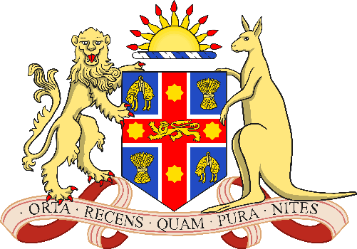
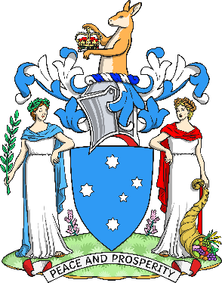

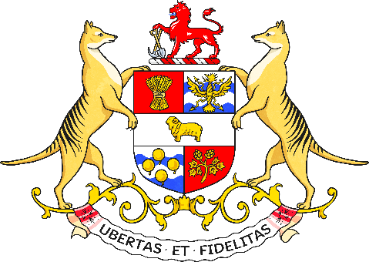

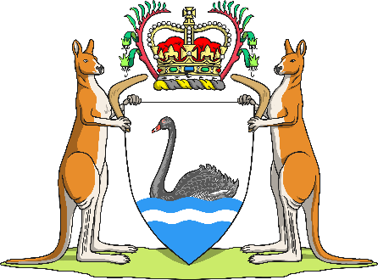
Six Colonies
New South Wales | Victoria | South Australia
Tasmania | Queensland | Western Australia

Slide 6

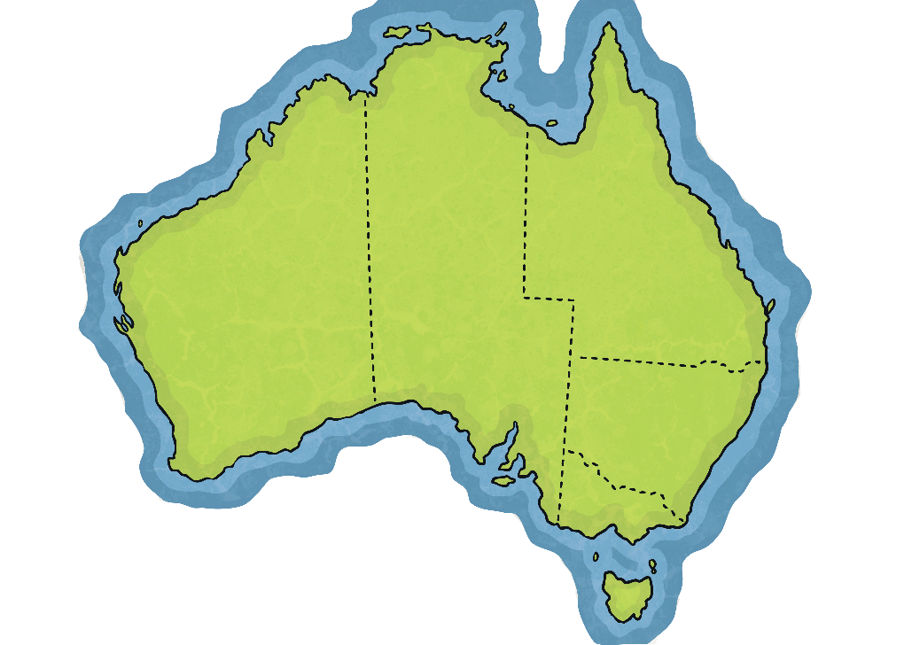

Six Colonies
On 1st January 1901, all six British colonies united to form one country: Australia.
This process was known as Federation.
But why did Australia’s Federation happen?
Let’s find out!
?
?
Did You Know?
X
The official name for Australia is the Commonwealth of Australia.
X
Can you think of any reasons why the colonies might have wanted to unite?

Slide 7
Six Colonies
We can identify four main reasons for Australia’s Federation.
Free trade
Defence
Immigration
National pride
These four reasons combined to set Australia on the path to Federation.

Slide 8
Free Trade
Before Federation, trade between the six British colonies of Australia was very complicated.
Each colony collected different tariffs (taxes) on goods that crossed its borders.
Tariffs
Advantages | Disadvantages
Increased money for government | Products were expensive
 | Limited the range of goods for sale
 | Difficult for manufacturers outside the colony to compete

Slide 9
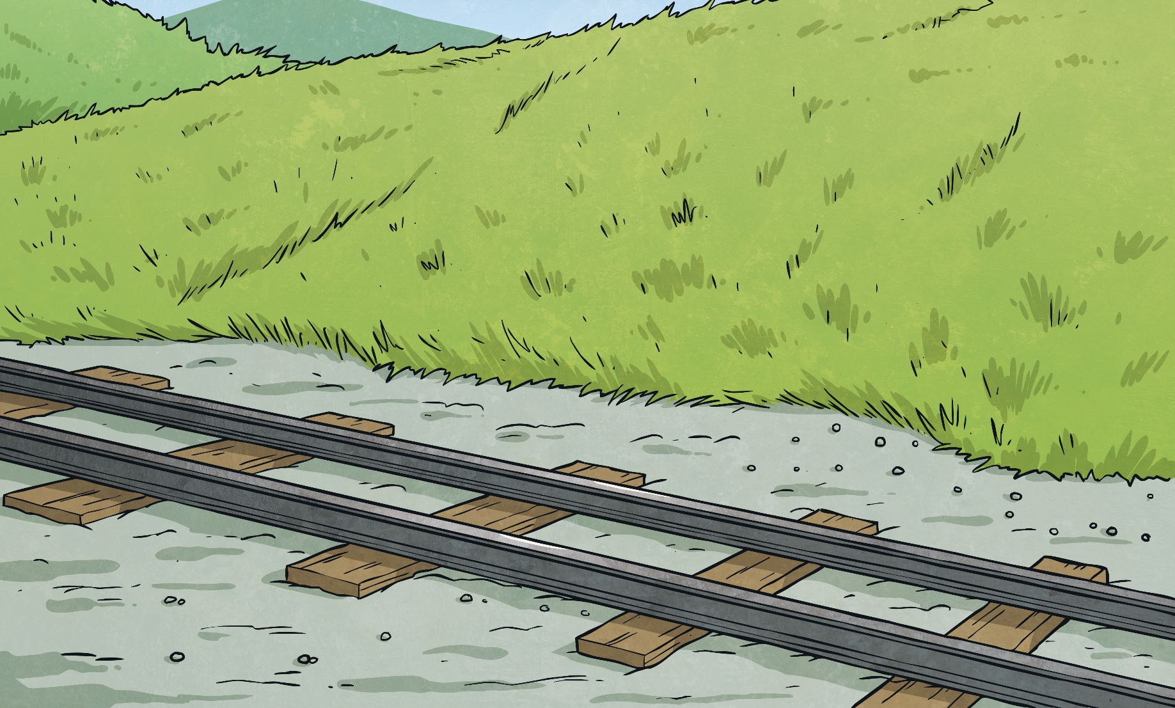

Free Trade
Travel between the colonies was very difficult. Passenger’s bags were inspected by officials at each border and this often added hours to a journey.
Railways
Each state had a different railway gauge (gap between the rails). This meant goods had to switch trains each time they crossed a border!
Each colony even had its own stamps. Fortunately, they still all used British currency (notes and coins) to buy and sell goods.
As a result, many people wanted to unite as one country to make travel and trade cheaper and easier.

Slide 10


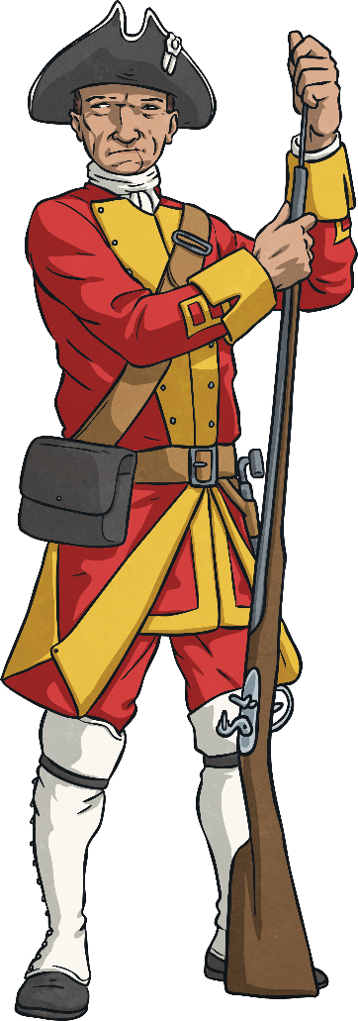
Defence
Panic in Melbourne
Before Federation, each colony had its own defence force. This consisted of a small permanent army backed up by volunteers. No colony had any warships so they relied on the British navy to occasionally patrol Australia’s vast coastline.
Fear of invasion grew as powerful countries like Russia, Germany and France began to colonise other parts of the Pacific Ocean. Many believed it was simply a matter of time before one of these countries attacked Australia.
On many occasions during the 1800s, rumoured sightings of French warships sent waves of panic through Melbourne. Luckily, none of the rumours turned out to be true.

Slide 11


Defence
Australia’s small population but huge geographic size led to fears of invasion from other parts of the world as well.
Many believed that powerful countries like China and Japan, with their large populations, would be tempted to invade and take control of Australia for themselves.
As a result, many argued that the colonies should unite and form one powerful military force capable of repelling foreign invaders.
X
Why do you think other countries might have wanted to invade Australia?

Slide 12


Ten Strikes and You’re Out!
It’s time to consolidate what we have learnt so far.
Let’s play the Federation bowling game!

Slide 13





Ten Strikes and You’re Out!
What process saw the six British colonies unite to form one country: Australia?
f
e
d
e
r
a
t
i
o
n
x
Click on the letters that you think are missing to try to spell the correct answer. Every time you guess a letter incorrectly, press the bowling ball to make a pin disappear! Can you guess all of the missing letters before you strike out?
a
b
c
d
e
f
g
h
i
j
k
l
m
n
o
p
q
r
s
t
u
v
w
x
y
z

Slide 14
Ten Strikes and You’re Out!
What did the colonies fear from foreign countries?
i
n
v
a
s
i
o
n
a
b
c
d
e
f
g
h
i
j
k
l
m
n
o
p
q
r
s
t
u
v
w
x
y
z

Slide 15
Ten Strikes and You’re Out!
Which of the following was not different between each colony?
Railway gauge, Stamps, Currency, Tariffs
c
u
r
r
e
n
c
y
a
b
c
d
e
f
g
h
i
j
k
l
m
n
o
p
q
r
s
t
u
v
w
x
y
z

Slide 16

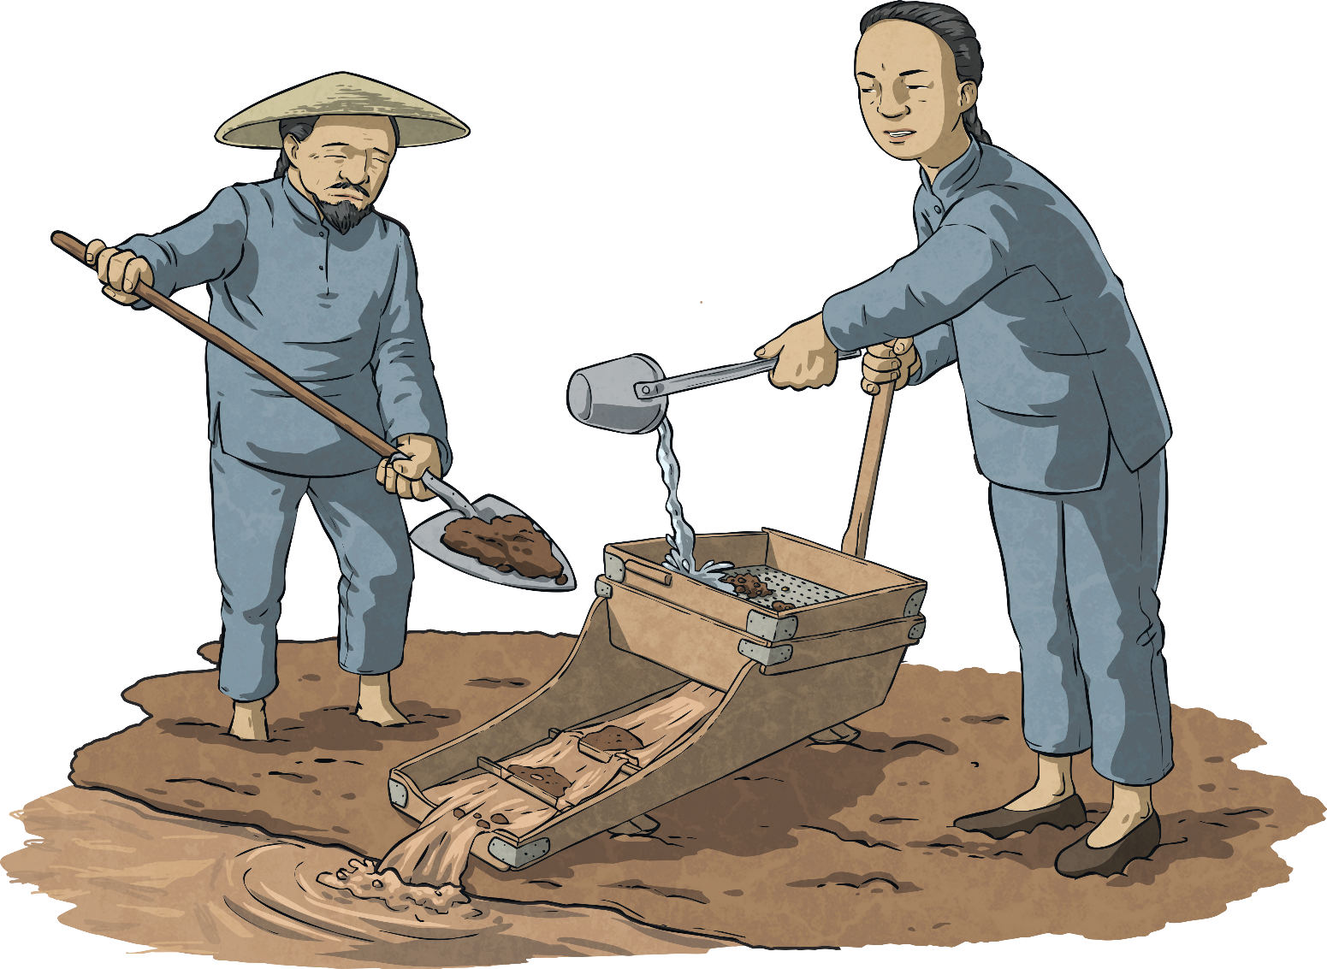
Immigration
Multiculturalism is where different cultural or racial groups have the same rights and opportunities within a society.
Chinese: Gold Rush
During the 1850s Gold Rush, Chinese migrants were treated very poorly. These same attitudes persisted through the years that led up to Federation.
Today, Australia is a thriving, multicultural country.
However, during the 1800s, many people wanted Australia to retain its dominant British heritage.
multiculturalism
Some people argued that multiculturalism would lead to racial violence.

Slide 17
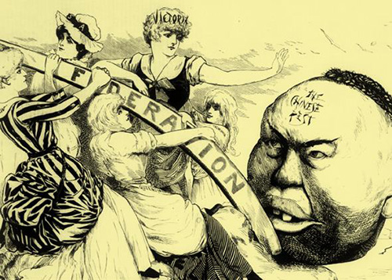
Immigration
People also feared the impact of ‘cheap’ labour from non-white countries. They argued that foreign workers, willing to work for less pay, would take jobs from colonists and that this would lead to a drop in the standard of living.
Pacific Islanders working for low pay in Queensland’s sugarcane fields were major targets for discrimination and mistreatment during this time.
As a result, many argued that a united Australia would allow greater control over immigration than if the six colonies remained separate.
X
How might a united Australia have been able to enforce stricter controls over immigration?

Slide 18

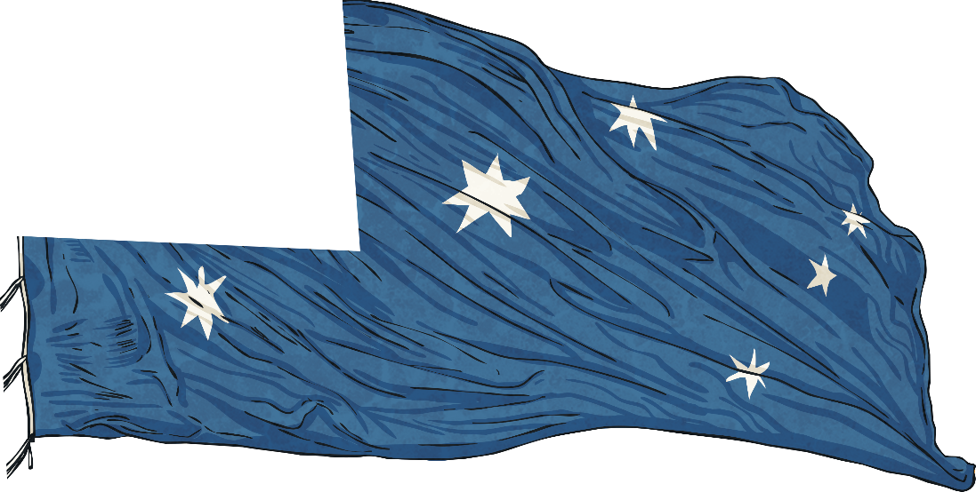
National Pride
Towards the end of the 1800s, however, many people began to identify as Australian. In fact, by the time of Federation almost 75% of the population had been born in Australia.
Most people living in the colonies shared a common British heritage. They spoke the same language and held similar values.

Slide 19




National Pride
In 1899, an army made up of soldiers drawn from all six colonies was sent to South Africa to fight in the Boer War.
Popular poetry and songs also fed this growing sense of national pride.
People felt more connected as they began to move between the colonies for work and leisure.
For the first time, sporting teams made up of players from all the colonies travelled overseas to represent Australia.
First Cricket Match
In 1877, a combined Australian cricket team played its first test match against England. The teams played two matches. Australia won one game; England won the other.
Banjo Paterson wrote his most famous poems around this time. These included:
Clancy of the Overflow (1889);
The Man from Snowy River (1890) and
Waltzing Matilda.
X
In your opinion, what things contribute to a sense of national identity?

Slide 20
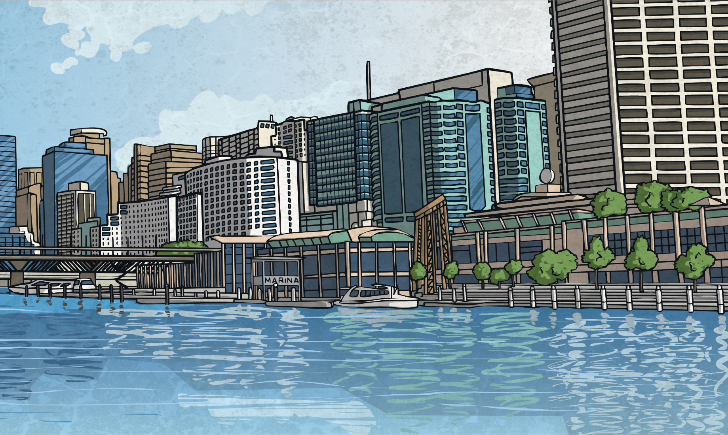
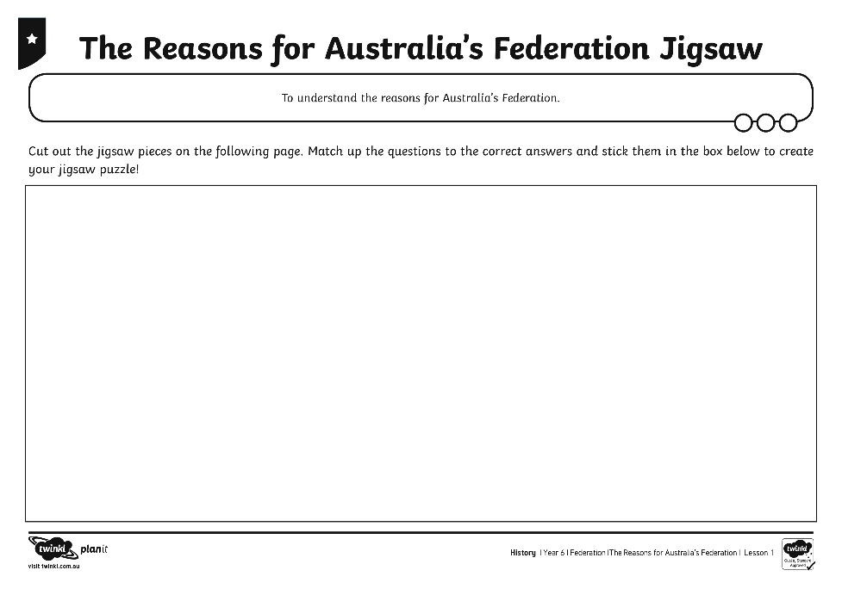
Jigsaw
Today, Australia is a thriving, prosperous and diverse country. It remains one of the only countries in the world that was not formed as a result of war.
On your own, complete The Reasons for Australia’s Federation Jigsaw Activity Sheet.
X
Now you know the four main reasons for Australia’s Federation. Which do you think was the most important reason and why?

Slide 21
Aim
To understand the reasons for Australia’s Federation.
Success Criteria
I can explain the reasons for Australia’s Federation.
I can identify the challenges faced by colonists and how these led to Federation.
I can discuss which reason for Australia’s Federation I believe was the most important and why.

